Slide 1

Advanced Probabilistic Machine Learning
Ralf Herbrich, Rainer Schlosser
Probability Theory

Slide 2
Course Setup
Goal: Enabled you to develop machine learning algorithms from scratch
We will pick the pace that helps you to get excited; please interrupt and ask questions!
Format: We have one topic per week with a lecture and tutorial
Lecture: Tuesday, 9:15am – 10:45am (HS2)
Tutorial: Wednesday: 3:15pm – 4:45pm (HS3)
Assignment: Five assignments to solve them (groups of two). They account for 40% of all points (8 points each)
Handed out every other week on Monday (starting 2nd week, October 20)
Each assignment has a theory and a practice part
Tutorial: Supporting the material of the lecture and the assignments
In the tutorial, Rainer will solve similar exercises to the assignments with you
We will answer questions you have with the actual assignments
Exam (60 points): Counts for 60% of all points; 120 minutes long (February 24)

Slide 3
Course Material
Books: All our material and communication will happen over Moodle
Bishop, C. Pattern Recognition and Machine Learning. Springer. 2006.
MacKay, D. Information Theory, Inference, and Learning Algorithms. CUP. 2003
Moodle: Share our lecture slides, tutorials, solutions
Location: https://moodle.hpi.de/course/view.php?id=982
Announcements: https://moodle.hpi.de/mod/forum/view.php?id=33393
GitHub Repository: Supporting material as well as code samples
Location: https://github.com/HPI-Artificial-Intelligence-Teaching/pml-wise2025
If you find mistakes, please submit issues and pull requests
GitHub Classrooms: Used for all our assignments
If you do not have a GitHub account, please create one now
Find a team member as assignments are solved in groups of two
More details tomorrow in the first tutorial

Slide 4
Course Structure
Foundation
Probability Theory (Unit 1)
Linear Algebra (Unit 2)
Methods
Graphical Models (Unit 3)
Exact Inference (Unit 4)
Approximate Inference: Expectation Propagation (Unit 5)
Approximate Inference: Variational Inference (Unit 6)
Approximate Inference: Mixture Models (Unit 7)
Approximate Inference: Message Approximation (Unit 8)
Applications
Text: Topic Models (Unit 9)
Images: Conditional Markov Random Fields (Unit 10)
Policies: Reinforcement Learning (Unit 11)

Slide 5
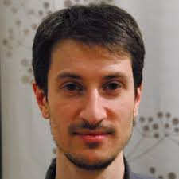
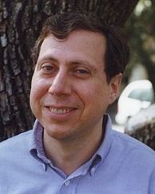


Julia
2012 developed by Jeff Bezanson, Alan Edelman, Stefan Karpinski and Viral B. Shah at MIT
Used for numerical and scientific computing with high performance
Execution speed is similar to C and FORTRAN
Hierarchical and parameterized type system as well as method overloading („multiple dispatching“) as central concepts
Native calls from C-(compiled) code possible (without wrappers)
Unicode is efficiently supported (e.g., UTF-8)
Alongside C, C++ and FORTRAN, the only programming language that has entered the “PetaFlop Club“
Jeff Bezanson (1981– )
Alan Edelman (1963 – )
Stefan Karpinski (1981– )
Viral Shah

Slide 6
Overview
Probability in Machine Learning
Probability Theory
Exponential Family Distributions

Slide 7
Overview
Probability in Machine Learning
Probability Theory
Exponential Family Distributions

Slide 8
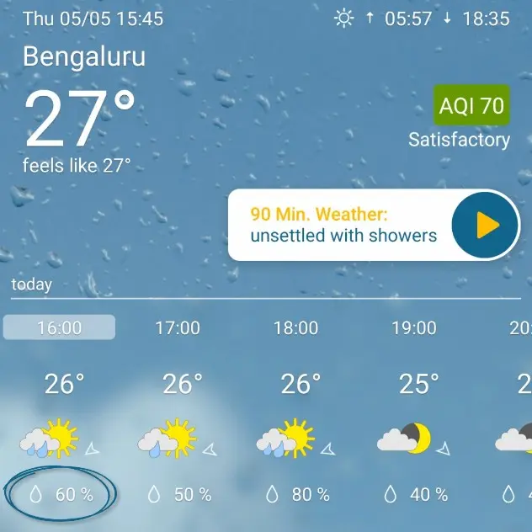
What is Probability?
Weather forecast: A meteorologist says
„Tomorrow, it is going to rain in Bangalore with 60%“
Two interpretations:
The meteorologist has analyzed all regions which have similar environmental conditions than Bangalore today. His (objective) estimate based on past data is that the procedure which predicts rain tomorrow is correct 60% of the time.
The meteorologist believes that it is more likely that it rains tomorrow in Bangalore (than it is to not rain tomorrow). 60% is the quantification of the (subjective) belief of the meteorologist.

Slide 9
Frequentist vs. Subjectivist Interpretation
Frequentist Interpretation
Probability is a property of the event (“it rains tomorrow in Bangalore”)
Is operationalized by repeated experiments
Typically used by scientists and engineers
Subjective Interpretation
Probability is an expression of belief of the person that makes a statement
Is subjective and people-dependent: Two people with identical data can come to different probabilities
Typically used by philosophers and economists
Probability is not a physical measure but a thought model for randomness!
The mathematical rules for probability are identical for both interpretations!

Slide 10
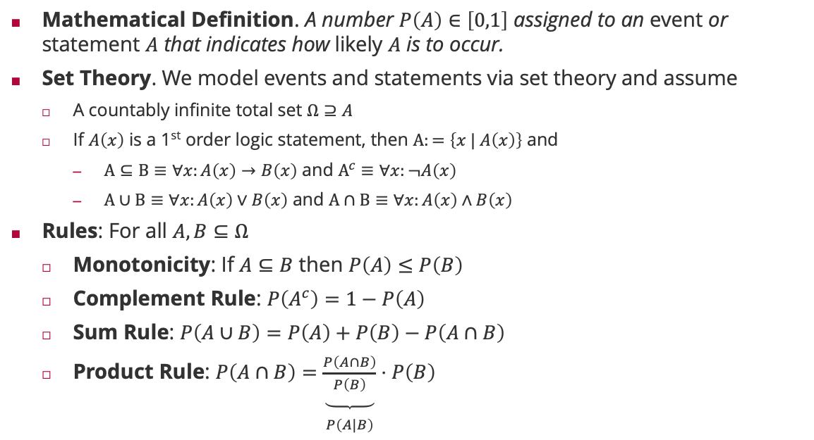
Rules of Probability
Mathematical Definition. A number $P\left(A\right)∈\left[0,1\right]$ assigned to an event or statement $A$ that indicates how likely $A$ is to occur.
Set Theory. We model events and statements via set theory and assume
A countably infinite total set $Ω⊇A$
If $A\left(x\right)$ is a 1st order logic statement, then $Α:=\left\{x | A\left(x\right)\right\}$ and
$Α⊆Β≡∀x:A\left(x\right)→B\left(x\right)$ and $Α^{c}≡∀x:¬A\left(x\right)$
$Α∪Β≡∀x:A\left(x\right)∨B\left(x\right)$ and $Α∩Β≡∀x:A\left(x\right)∧B\left(x\right)$
Rules: For all $A,B⊆Ω$
Monotonicity: If $A⊆B$ then $P\left(A\right)≤P\left(B\right)$
Complement Rule: $P\left(A^{c}\right)=1−P\left(A\right)$
Sum Rule: $P\left(A∪B\right)=P\left(A\right)+P\left(B\right)−P\left(A∩B\right)$
Product Rule: $P\left(A∩B\right)=\underset{\begin{aligned} \\ P\left(A|B\right)\end{aligned}}{\underbrace{\frac{P\left(A∩B\right)}{P\left(B\right)}}}⋅P\left(B\right)$

Slide 11
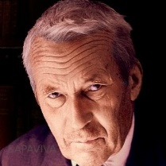
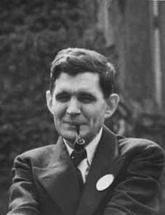
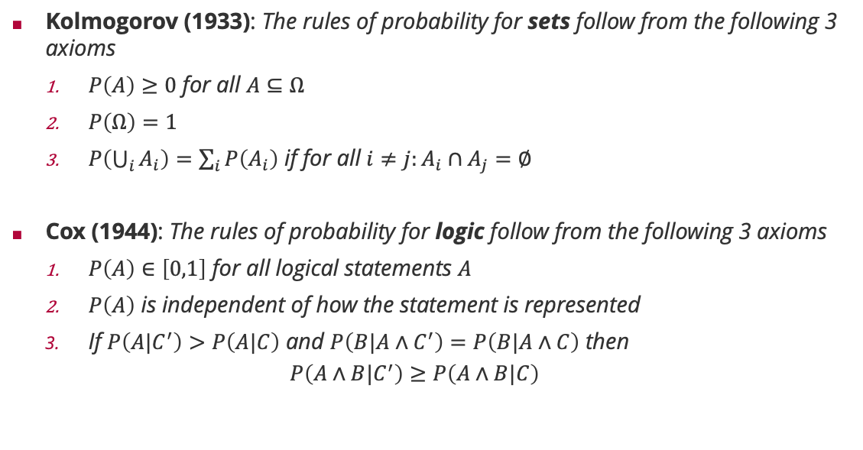
Frequentist vs. Subjective Probabilities
Kolmogorov (1933): The rules of probability for sets follow from the following 3 axioms
$P\left(A\right)≥0$ for all $A⊆Ω$
$P\left(Ω\right)=1$
$P\left(\bigcup_{i}{A_{i}}\right)=\sum_{i}{P\left(A_{i}\right)}$ if for all $i≠j:A_{i}∩A_{j}=∅$
Cox (1944): The rules of probability for logic follow from the following 3 axioms
$P\left(A\right)∈\left[0,1\right]$ for all logical statements $A$
$P\left(A\right)$ is independent of how the statement is represented
If $P\left(A|C^{′}\right)>P\left(A|C\right)$ and $P\left(B|A∧C^{′}\right)=P\left(B|A∧C\right)$ then
$$P\left(A∧B|C^{′}\right)≥P\left(A∧B|C\right)$$
Andrey Kolmogorov (1903 – 1987)
Richard Threlkeld Cox (1898 – 1991)

Slide 12
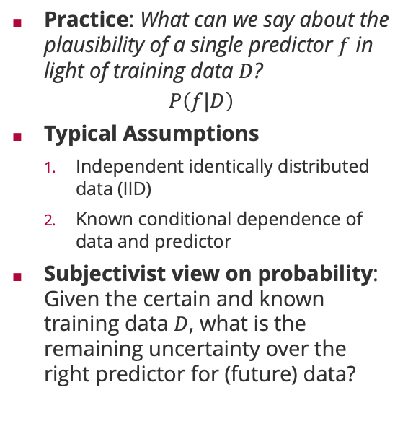
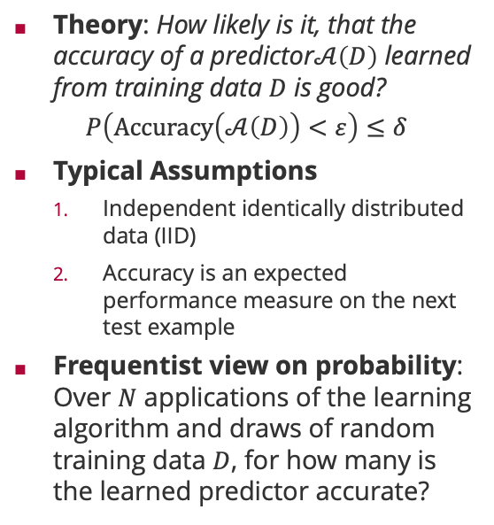
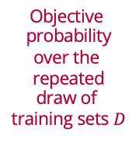
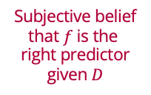
The Role of Probability in Machine Learning
Theory: How likely is it, that the accuracy of a predictor$𝒜\left(D\right)$ learned from training data $D$ is good?
$$P\left(Accuracy\left(𝒜\left(D\right)\right)<ε\right)≤δ$$
Typical Assumptions
Independent identically distributed data (IID)
Accuracy is an expected performance measure on the next test example
Frequentist view on probability: Over $N$ applications of the learning algorithm and draws of random training data $D$, for how many is the learned predictor accurate?
Practice: What can we say about the plausibility of a single predictor $f$ in light of training data $D$?
$$P\left(f|D\right)$$
Typical Assumptions
Independent identically distributed data (IID)
Known conditional dependence of data and predictor
Subjectivist view on probability: Given the certain and known training data $D$, what is the remaining uncertainty over the right predictor for (future) data?
Objective probability over the repeated draw of training sets $D$
Subjective belief that $f$ is the right predictor given $D$

Slide 13
Overview
Probability in Machine Learning
Probability Theory
Exponential Family Distributions

Slide 14


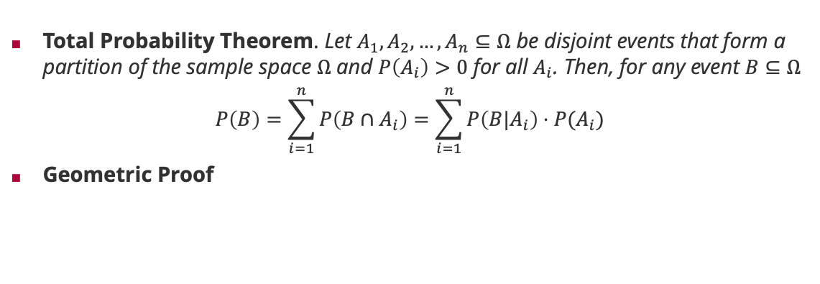








Probability Theory: Law of Total Probability
Total Probability Theorem. Let $A_{1},A_{2},…,A_{n}⊆Ω$ be disjoint events that form a partition of the sample space $Ω$ and $P\left(A_{i}\right)>0$ for all $A_{i}$. Then, for any event $B⊆Ω$
$$P\left(B\right)=\sum_{i=1}^{n}{P\left(B∩A_{i}\right)}=\sum_{i=1}^{n}{P\left(B|A_{i}\right)⋅P(A_{i})}$$
Geometric Proof
$$A_{1}$$
$$A_{2}$$
$$P(B∩A_{1})$$
$$B$$
$$P(B∩A_{2})$$
$$P(B∩A_{4})$$
$$P(B∩A_{3})$$
$$A_{4}$$
$$A_{3}$$
$$Ω$$
Notes:
Central concept for probabilistic machine learning when summing out latent variables that “cause” the data!

Slide 15
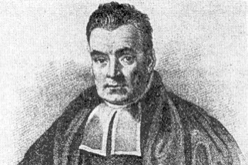
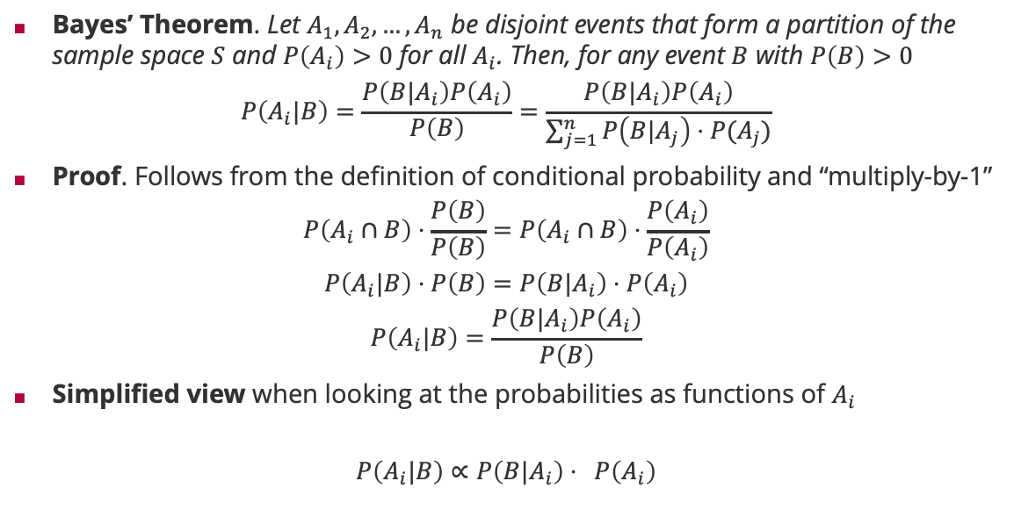

Probability Theory: Bayes Rule
Bayes’ Theorem. Let $A_{1},A_{2},…,A_{n}$ be disjoint events that form a partition of the sample space $S$ and $P\left(A_{i}\right)>0$ for all $A_{i}$. Then, for any event $B$ with $P\left(B\right)>0$
$$P\left(A_{i}|B\right)=\frac{P\left(B|A_{i}\right)P\left(A_{i}\right)}{P\left(B\right)}=\frac{P\left(B|A_{i}\right)P\left(A_{i}\right)}{\sum_{j=1}^{n}{P\left(B|A_{j}\right)⋅P(A_{j})}}$$
Proof. Follows from the definition of conditional probability and “multiply-by-1”
$$P\left(A_{i}∩B\right)⋅\frac{P\left(B\right)}{P\left(B\right)}=P\left(A_{i}∩B\right)⋅\frac{P\left(A_{i}\right)}{P\left(A_{i}\right)}$$
$$P\left(A_{i}|B\right)⋅P\left(B\right)=P\left(B|A_{i}\right)⋅P\left(A_{i}\right)$$
$$P\left(A_{i}|B\right)=\frac{P\left(B|A_{i}\right)P\left(A_{i}\right)}{P\left(B\right)}$$
Simplified view when looking at the probabilities as functions of $A_{i}$
$$P\left(A_{i}|B\right)∝P\left(B|A_{i}\right)⋅ P\left(A_{i}\right)$$
law of total probability
(Rev) Thomas Bayes (1701 – 1761)
=1 (by definition $P\left(A_{i}\right)>0$ and $P\left(B\right)>0$)
by definition of conditional probability
posterior
likelihood
prior
Notes:
Central concept for probabilistic machine learning when $A_{i}$ is the event “predictor $f_{i}$ is the predictor of the dataset” and $B$ is the event “data set $D$ is observed”.

Slide 16
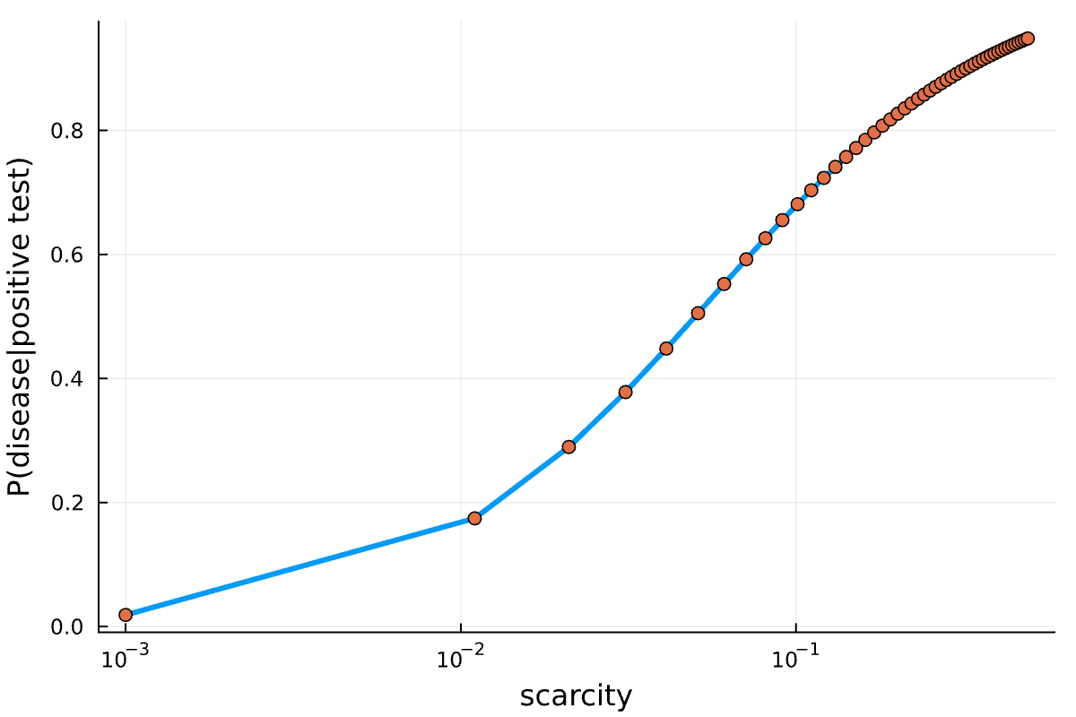
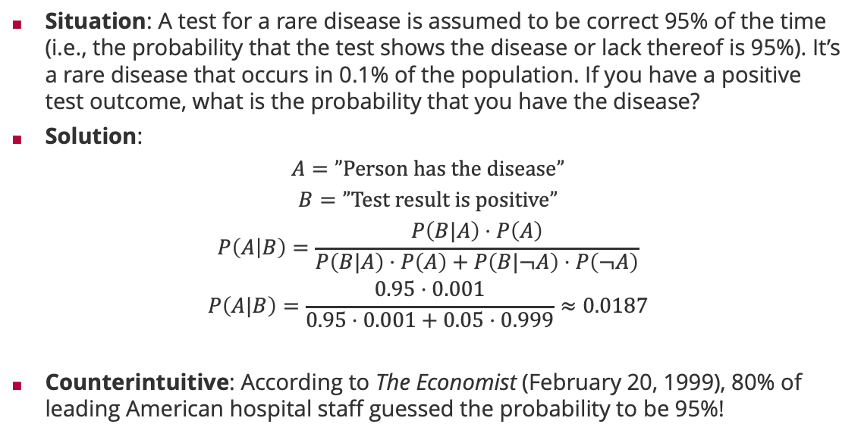
Bayes Rule: False-Positive Puzzle
Situation: A test for a rare disease is assumed to be correct 95% of the time (i.e., the probability that the test shows the disease or lack thereof is 95%). It’s a rare disease that occurs in 0.1% of the population. If you have a positive test outcome, what is the probability that you have the disease?
Solution:
$$A=”Person has the disease”$$
$$B=”Test result is positive”$$
$$P\left(A | B\right)=\frac{P\left(B|A\right)⋅P\left(A\right)}{P\left(B|A\right)⋅P\left(A\right)+P\left(B|¬A\right)⋅P\left(¬A\right)}$$
$$P\left(A|B\right)=\frac{0.95⋅0.001}{0.95⋅0.001+0.05⋅0.999}≈0.0187$$
Counterintuitive: According to The Economist (February 20, 1999), 80% of leading American hospital staff guessed the probability to be 95%!

Slide 17

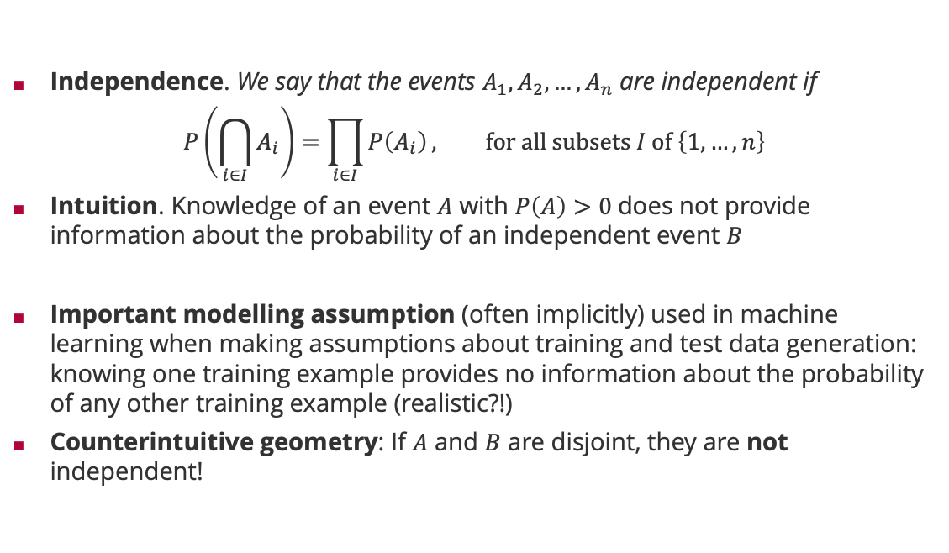


Probability Theory: Independence
Independence. We say that the events $A_{1},A_{2},…,A_{n}$ are independent if
$$P\left(\bigcap_{i∈I}{A_{i}}\right)=\prod_{i∈I}{P\left(A_{i}\right)}, for all subsets I of \left\{1,…,n\right\}$$
Intuition. Knowledge of an event $A$ with $P\left(A\right)>0$does not provide information about the probability of an independent event $B$
Important modelling assumption (often implicitly) used in machine learning when making assumptions about training and test data generation: knowing one training example provides no information about the probability of any other training example (realistic?!)
Counterintuitive geometry: If $A$ and $B$ are disjoint, they are not independent!
$=P\left(B∩A\right)$
$$P\left(B|A\right)=P(B)$$
$$⇔P\left(B|A\right)⋅P(A)=P\left(B\right)⋅P\left(A\right)$$

Slide 18
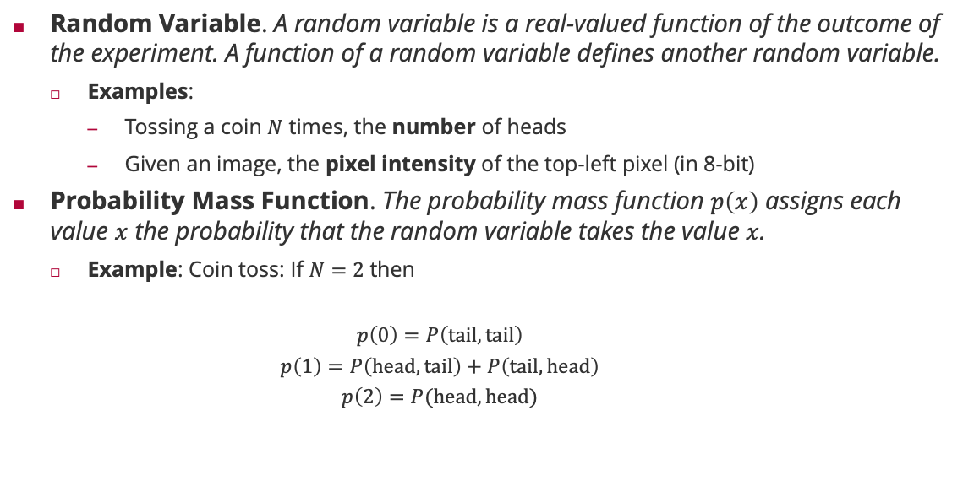
Probability Theory: Random Variable
Random Variable. A random variable is a real-valued function of the outcome of the experiment. A function of a random variable defines another random variable.
Examples:
Tossing a coin $N$ times, the number of heads
Given an image, the pixel intensity of the top-left pixel (in 8-bit)
Probability Mass Function. The probability mass function $p\left(x\right)$ assigns each value $x$ the probability that the random variable takes the value $x$.
Example: Coin toss: If $N=2$ then
$$p\left(0\right)=P\left(tail,tail\right)$$
$$p\left(1\right)=P\left(head,tail\right)+P\left(tail,head\right)$$
$$p\left(2\right)=P(head,head)$$

Slide 19


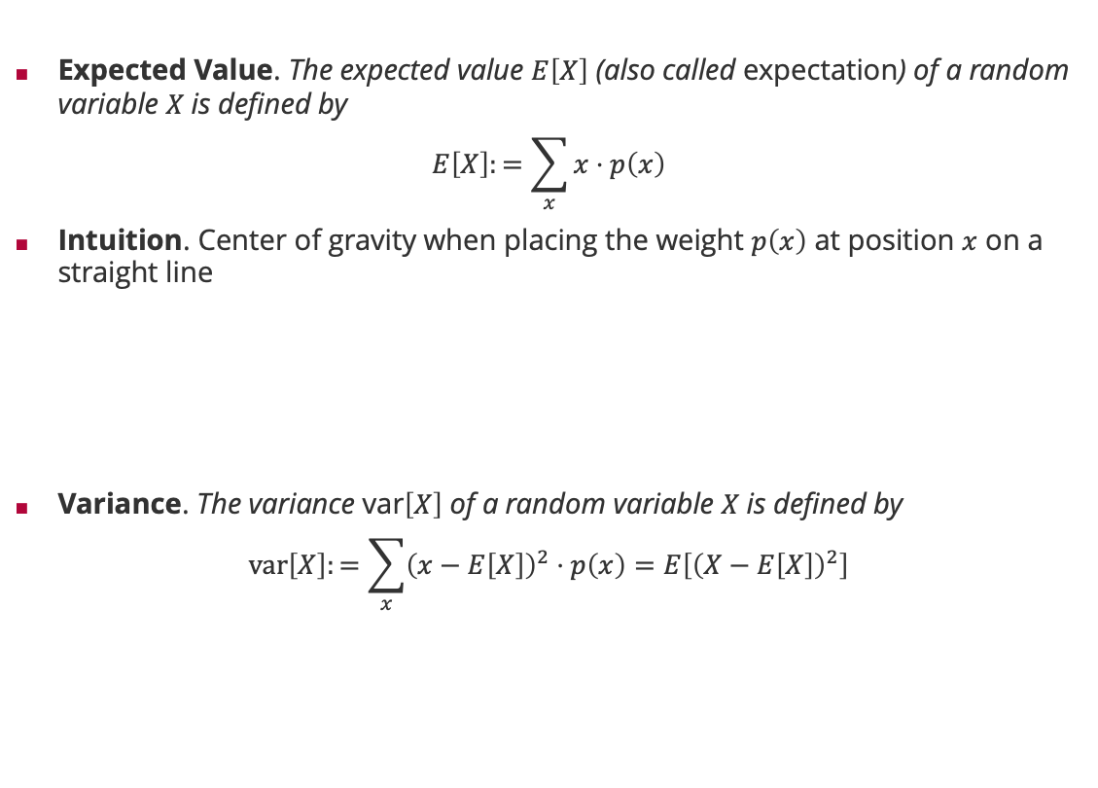



Probability Theory: Expectation and Variance
Expected Value. The expected value $E\left[X\right]$ (also called expectation) of a random variable $X$is defined by
$$E\left[X\right]:=\sum_{x}{x⋅p\left(x\right)}$$
Intuition. Center of gravity when placing the weight $p\left(x\right)$ at position $x$ on a straight line
Variance. The variance var$\left[X\right]$ of a random variable $X$is defined by
$$var\left[X\right]:=\sum_{x}{{\left(x−E\left[X\right]\right)}^{2}⋅p\left(x\right)=E\left[{\left(X−E\left[X\right]\right)}^{2}\right]}$$
$$P\left(1\right)$$
$$P\left(4\right)$$
$$P\left(2\right)$$
$$P\left(3\right)$$
$$E\left[X\right]$$

Slide 20
Overview
Probability in Machine Learning
Probability Theory
Exponential Family Distributions

Slide 21
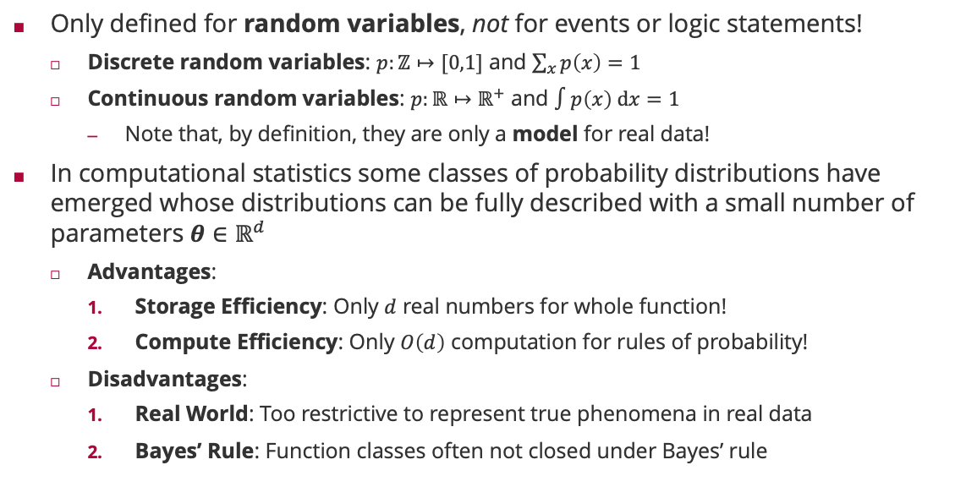
Probability Distributions
Only defined for random variables, not for events or logic statements!
Discrete random variables: $p:ℤ↦[0,1]$ and $\sum_{x}{p\left(x\right)}=1$
Continuous random variables: $p:ℝ↦ℝ^{+}$ and $∫p\left(x\right) dx=1$
Note that, by definition, they are only a model for real data!
In computational statistics some classes of probability distributions have emerged whose distributions can be fully described with a small number of parameters $θ∈ℝ^{d}$
Advantages:
Storage Efficiency: Only $d$ real numbers for whole function!
Compute Efficiency: Only $O\left(d\right)$ computation for rules of probability!
Disadvantages:
Real World: Too restrictive to represent true phenomena in real data
Bayes’ Rule: Function classes often not closed under Bayes’ rule

Slide 22

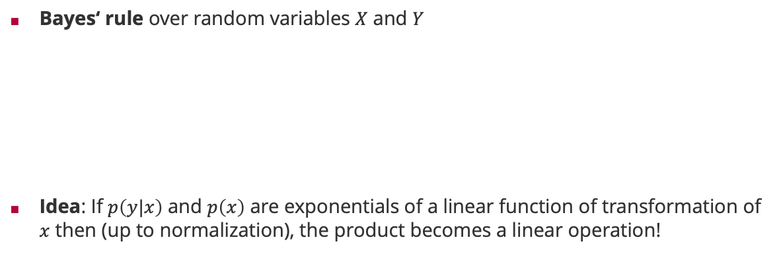

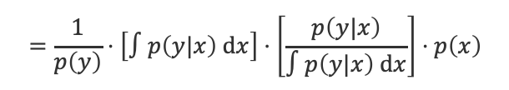
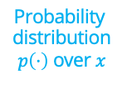
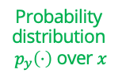

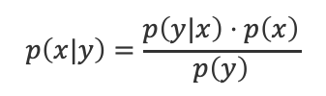

Efficient Bayes’ Rule
Bayes‘ rule over random variables $X$ and $Y$
Idea: If $p\left(y|x\right)$ and $p\left(x\right)$ are exponentials of a linear function of transformation of $x$ then (up to normalization), the product becomes a linear operation!
$$p\left(x|y\right)=\frac{p\left(y|x\right)⋅p\left(x\right)}{p\left(y\right)}$$
$$=\frac{1}{p\left(y\right)}⋅\left[∫p\left(y|x\right) dx\right]⋅\left[\frac{p\left(y|x\right)}{∫p\left(y|x\right) dx}\right]⋅p\left(x\right)$$
Normalization constant independent of $x$
Probability distribution $p_{y}\left(⋅\right)$ over $x$
Probability distribution $p\left(⋅\right)$ over $x$
$$p\left(y|x\right)∝\exp\left(θ_{y}^{T}⋅T\left(x\right)\right)$$
$$p\left(x|y\right)∝\exp\left({\left[θ_{y}+θ\right]}^{T}⋅T\left(x\right)\right)$$
$$p\left(x\right)∝\exp\left(θ^{T}⋅T\left(x\right)\right)$$
Product in distribution becomes addition!

Slide 23
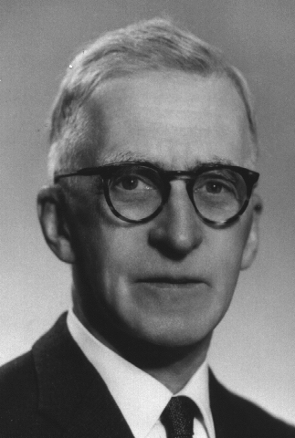
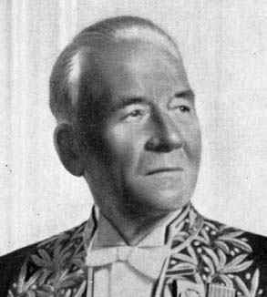
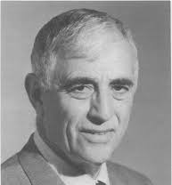

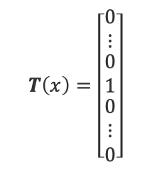
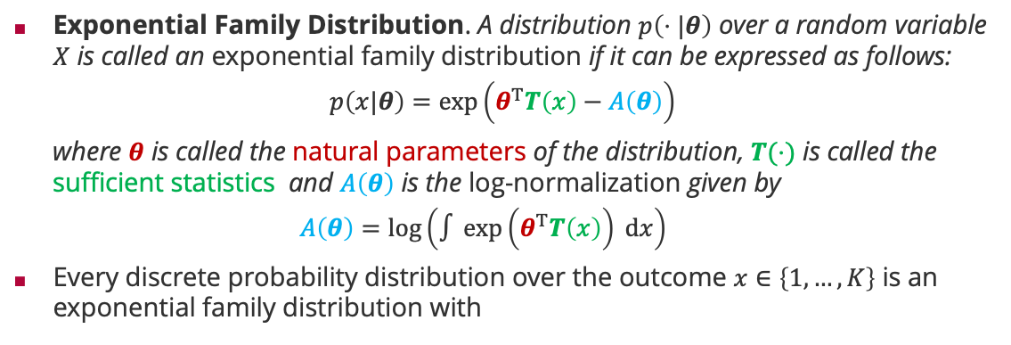
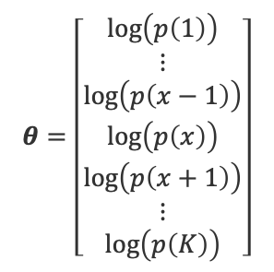
Exponential Family
Exponential Family Distribution. A distribution $p\left(⋅|θ\right)$ over a random variable $X$ is called an exponential family distribution if it can be expressed as follows:
$$p\left(x|θ\right)=\exp\left(θ^{T}T\left(x\right)−A\left(θ\right)\right)$$
where $θ$ is called the natural parameters of the distribution, $T(⋅)$ is called the sufficient statistics and $A\left(θ\right)$ is the log-normalization given by
$$A\left(θ\right)=\log\left(∫\exp\left(θ^{T}T\left(x\right)\right) dx\right)$$
Every discrete probability distribution over the outcome $x∈\left\{1,…,K\right\}$ is an exponential family distribution with
Edwin J. G. Pitman (1897 – 1993)
Georges Darmois (1888 - 1960)
Bernhard O. Koopman (1900 – 1981)
$$θ=\left[\begin{matrix}\log\left(p\left(1\right)\right) \\ ⋮ \\ \begin{matrix}\log\left(p\left(x−1\right)\right) \\ \log\left(p\left(x\right)\right) \\ \begin{matrix}\log\left(p\left(x+1\right)\right) \\ ⋮ \\ \log\left(p\left(K\right)\right)\end{matrix}\end{matrix}\end{matrix}\right]$$
$$T\left(x\right)=\left[\begin{matrix}0 \\ ⋮ \\ \begin{matrix}0 \\ 1 \\ \begin{matrix}0 \\ ⋮ \\ 0\end{matrix}\end{matrix}\end{matrix}\right]$$
Index $x$

Slide 24
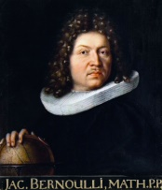



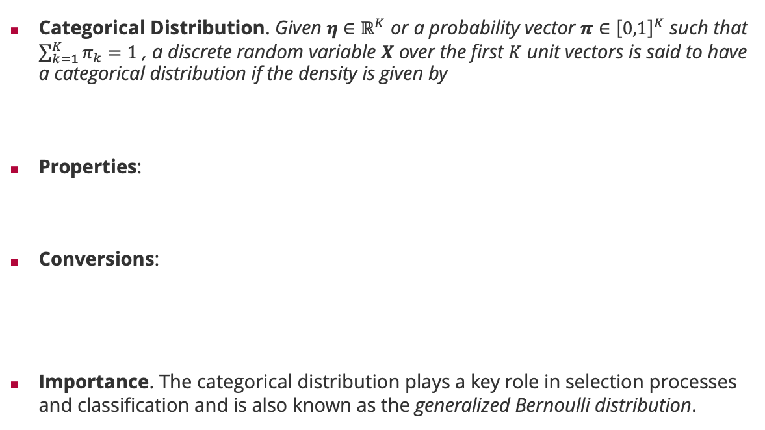
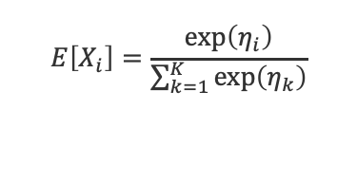
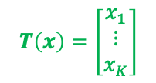

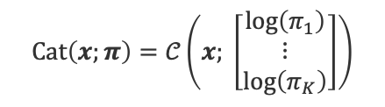
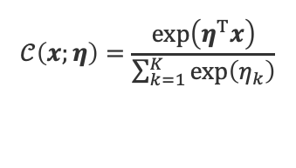
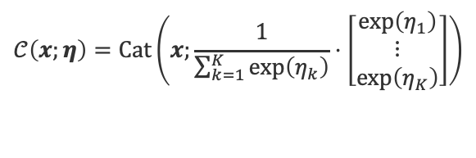
Exponential Family Distributions: Categorical Distribution
Categorical Distribution. Given $η∈ℝ^{K}$ or a probability vector $π∈{\left[0,1\right]}^{K}$ such that $\sum_{k=1}^{K}{π_{k}}=1$ , a discrete random variable $X$ over the first $K$ unit vectors is said to have a categorical distribution if the density is given by
Properties:
Conversions:
Importance. The categorical distribution plays a key role in selection processes and classification and is also known as the generalized Bernoulli distribution.
$$𝒞\left(x;η\right)=\frac{\exp\left(η^{T}x\right)}{\sum_{k=1}^{K}{\exp\left(η_{k}\right)}}$$
$$Cat\left(x;π\right)=π^{T}x$$
Jacob Bernoulli (1655 – 1705)
$$E\left[X_{i}\right]=\frac{\exp\left(η_{i}\right)}{\sum_{k=1}^{K}{\exp\left(η_{k}\right)}}$$
$$T\left(x\right)=\left[\begin{matrix}x_{1} \\ ⋮ \\ x_{K}\end{matrix}\right]$$
$$θ=\left[\begin{matrix}\log\left(π_{1}\right) \\ ⋮ \\ \log\left(π_{K}\right)\end{matrix}\right]$$
$$=π_{i}$$
$$var\left[X_{i}\right]=π_{i}⋅\left(1−π_{i}\right)$$
$$𝒞\left(x;η\right)=Cat\left(x;\frac{1}{\sum_{k=1}^{K}{\exp\left(η_{k}\right)}}⋅\left[\begin{matrix}\exp\left(η_{1}\right) \\ ⋮ \\ \exp\left(η_{K}\right)\end{matrix}\right]\right)$$
$$Cat\left(x;π\right)=𝒞\left(x; \left[\begin{matrix}\log\left(π_{1}\right) \\ ⋮ \\ \log\left(π_{K}\right)\end{matrix}\right]\right)$$

Slide 25
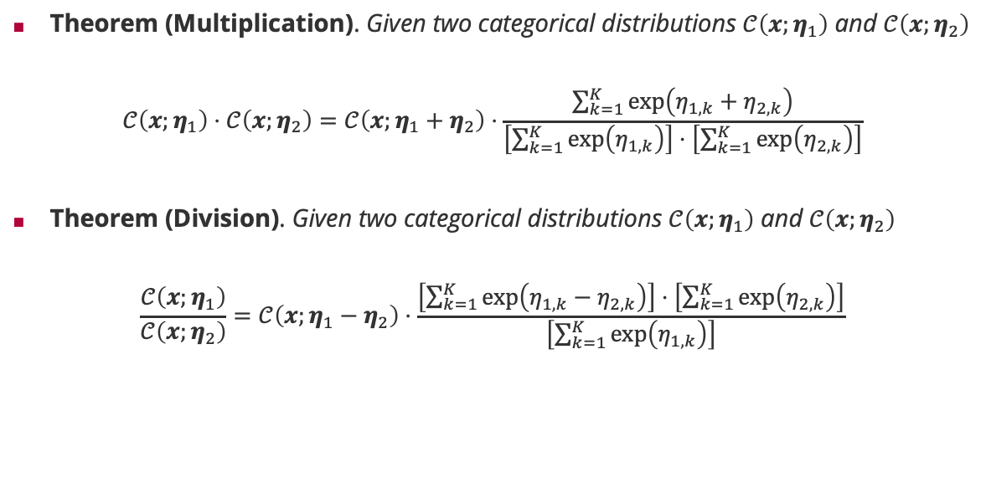
Categorical Distribution: Efficient Products & Divisions
Theorem (Multiplication). Given two categorical distributions $𝒞\left(x;η_{1}\right)$ and $𝒞\left(x;η_{2}\right)$
$$𝒞\left(x;η_{1}\right)⋅𝒞\left(x;η_{2}\right)=𝒞\left(x;η_{1}+η_{2}\right)⋅\frac{\sum_{k=1}^{K}{\exp\left(η_{1,k}+η_{2,k}\right)}}{\left[\sum_{k=1}^{K}{\exp\left(η_{1,k}\right)}\right]⋅\left[\sum_{k=1}^{K}{\exp\left(η_{2,k}\right)}\right]}$$
Theorem (Division). Given two categorical distributions $𝒞\left(x;η_{1}\right)$ and $𝒞\left(x;η_{2}\right)$
$$\frac{𝒞\left(x;η_{1}\right)}{𝒞\left(x;η_{2}\right)}=𝒞\left(x;η_{1}−η_{2}\right)⋅\frac{\left[\sum_{k=1}^{K}{\exp\left(η_{1,k}−η_{2,k}\right)}\right]⋅\left[\sum_{k=1}^{K}{\exp\left(η_{2,k}\right)}\right]}{\left[\sum_{k=1}^{K}{\exp\left(η_{1,k}\right)}\right]}$$
Correction factor
Additive updates!
Correction factor
Subtractive updates!

Slide 26
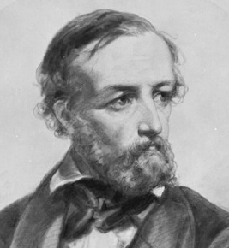


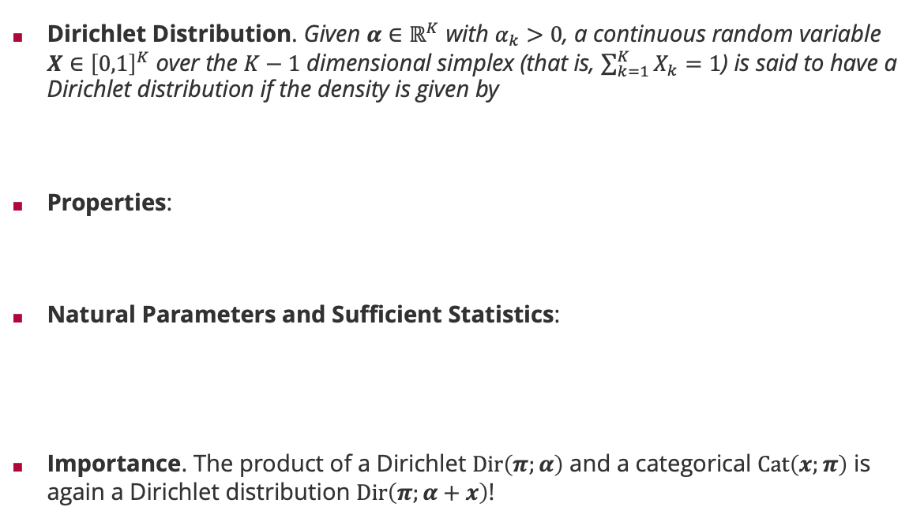



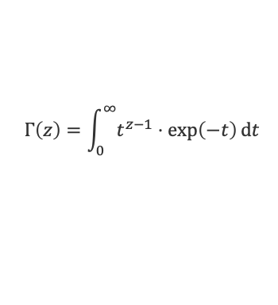
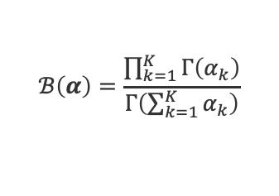
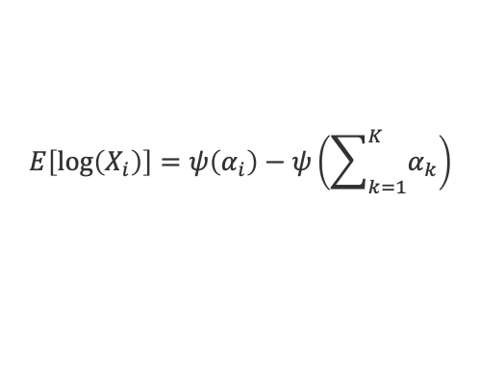

Exponential Family Distributions: Dirichlet Distribution
Dirichlet Distribution. Given $α∈ℝ^{K}$ with $α_{k}>0$, a continuous random variable $X∈{\left[0,1\right]}^{K}$ over the $K−1$ dimensional simplex (that is, $\sum_{k=1}^{K}{X_{k}}=1$) is said to have a Dirichlet distribution if the density is given by
Properties:
Natural Parameters and Sufficient Statistics:
Importance. The product of a Dirichlet $Dir\left(π;α\right)$ and a categorical $Cat\left(x;π\right)$ is again a Dirichlet distribution $Dir\left(π;α+x\right)$!
$$Dir\left(x;α\right)=\frac{1}{ℬ\left(α\right)}⋅\prod_{k=1}^{K}{x_{k}^{α_{k}−1}}$$
$$ℬ\left(α\right)=\frac{\prod_{k=1}^{K}{Γ\left(α_{k}\right)}}{Γ\left(\sum_{k=1}^{K}{α_{k}}\right)}$$
Peter Gustav Dirichlet (1805 – 1859)
$$E\left[X_{i}\right]=\frac{α_{i}}{\sum_{k=1}^{K}{α_{k}}}$$
$$Γ\left(z\right)=\int_{0}^{∞}{t^{z−1}⋅\exp\left(−t\right)}dt$$
$$E\left[\log\left(X_{i}\right)\right]=ψ\left(α_{i}\right)−ψ\left(\sum_{k=1}^{K}{α_{k}}\right)$$
$$ψ\left(z\right)=\frac{d}{dz}\log\left(Γ\left(z\right)\right)$$
$$T\left(x\right)=\left[\begin{matrix}\log\left(x_{1}\right) \\ ⋮ \\ \log\left(x_{K}\right)\end{matrix}\right]$$
$$θ=\left[\begin{matrix}α_{1}−1 \\ ⋮ \\ α_{K}−1\end{matrix}\right]$$
$$∀z>0: Γ\left(z+1\right)=z⋅Γ\left(z\right)$$

Slide 27

Dirichlet Distribution: Efficient Products & Divisions
Theorem (Multiplication). Given two Dirichlet distributions $Dir\left(x;α_{1}\right)$ and $Dir\left(x;α_{2}\right)$
$$Dir\left(x;α_{1}\right)⋅Dir\left(x;α_{2}\right)=Dir\left(x;α_{1}+α_{2}−1\right)⋅\frac{ℬ\left(α_{1}+α_{2}−1\right)}{ℬ\left(α_{1}\right)⋅ℬ\left(α_{2}\right)}$$
Theorem (Division). Given two Dirichlet distributions $Dir\left(x;α_{1}\right)$ and $Dir\left(x;α_{2}\right)$
$$\frac{Dir\left(x;α_{1}\right)}{Dir\left(x;α_{2}\right)}=Dir\left(x;α_{1}−α_{2}+1\right)⋅\frac{ℬ\left(α_{1}−α_{2}+1\right)⋅ℬ\left(α_{2}\right)}{ℬ\left(α_{1}\right)}$$
Correction factor
Additive updates!
Correction factor
Subtractive updates!

Slide 28


Exponential Family Distributions: 1D Gaussian
1D Gaussian Distribution. A continuous random variable $X$ is said to have a one-dimensional Gaussian distribution if the density is given by
$$𝒩\left(x;μ,σ^{2}\right)=\frac{1}{\sqrt{2π}σ}⋅\exp\left(−\frac{{\left(x−μ\right)}^{2}}{2σ^{2}}\right)$$
Properties:
$$E\left[X\right]=μ$$
$$var\left[X\right]=σ^{2}$$
Importance. The 1D Gaussian distribution plays a fundamental role in ML!
Data Modelling: The limit distribution for the sum of a large number of independent and identically distributed random variables.
Machine Learning: The most common belief distribution for the parameters of prediction functions!
Information Theory: The distribution function with the most uncertainty (“entropy”) when fixing mean and variance of the random variable.
Carl Friedrich Gauss (1777 - 1855)

Slide 29




1D Gaussian Distribution: Representations
Scale-Location Parameters
$$𝒩\left(x;μ,σ^{2}\right)=\frac{1}{\sqrt{2π}σ}⋅\exp\left(−\frac{{\left(x−μ\right)}^{2}}{2σ^{2}}\right)$$
Conversions
$$𝒩\left(x;μ,σ^{2}\right)=𝒢\left(x;\frac{μ}{σ^{2}},\frac{1}{σ^{2}}\right)$$
Posterior Inference
Natural Parameters
$$𝒢\left(x;τ,ρ\right)=\sqrt{\frac{ρ}{2π}}⋅\exp\left(−\frac{τ^{2}}{2ρ}\right)⋅\exp\left(τ⋅x−ρ⋅\frac{x^{2}}{2}\right)$$
Conversions
$$𝒢\left(x;τ,ρ\right)=𝒩\left(x;\frac{τ}{ρ},\frac{1}{ρ}\right)$$
Posterior Inference
Two divisions only!
$$T\left(x\right)=\left[\begin{matrix}x \\ −\frac{x^{2}}{2}\end{matrix}\right]$$
$$θ=\left[\begin{matrix}τ \\ ρ\end{matrix}\right]$$

Slide 30

1D Gaussian Distribution: Efficient Products & Divisions
Theorem (Multiplication). Given two one-dimensional Gaussian distributions $𝒢\left(x;τ_{1},ρ_{1}\right)$ and $𝒢\left(x;τ_{2},ρ_{2} \right)$ we have
$$𝒢\left(x;τ_{1},ρ_{1}\right)⋅𝒢\left(x;τ_{2},ρ_{2}\right)=𝒢\left(x;τ_{1}+τ_{2},ρ_{1}+ρ_{2}\right)⋅𝒩\left(μ_{1};μ_{2},σ_{1}^{2}+σ_{2}^{2}\right)$$
Theorem (Division). Given two one-dimensional Gaussian distributions $𝒢\left(x;τ_{1},ρ_{1}\right)$ and $𝒢\left(x;τ_{2},ρ_{2}\right)$ where $ρ_{1}>ρ_{2}$ we have
$$\frac{𝒢\left(x;τ_{1},ρ_{1}\right)}{𝒢\left(x;τ_{2},ρ_{2}\right)}=\frac{𝒢\left(x;τ_{1}−τ_{2},ρ_{1}−ρ_{2}\right)}{𝒩\left(μ_{1};μ_{2},σ_{2}^{2}−σ_{1}^{2}\right)}⋅\frac{σ_{2}^{2}}{σ_{2}^{2}−σ_{1}^{2}}$$
Gaussian density
Additive updates!
Correction factor
Subtractive updates!
Gaussian density

Slide 31


Limit 1D Gaussian Distributions: Dirac Delta and Uniform
Dirac Delta. The Dirac delta function $δ\left(⋅\right)$ is defined as the limit $σ^{2}→0$
$$δ\left(x\right)=\lim_{σ^{2}→0}{𝒩\left(x;0,σ^{2}\right)}$$
Gaussian Uniform. The Gaussian uniform $𝒰\left(⋅\right)$ is defined as the limit $σ^{2}→∞$
$$𝒰\left(x\right)=\lim_{σ^{2}→+∞}{𝒩\left(x;0,σ^{2}\right)}$$
Theorem (Convolution of Normal with Dirac). For any $μ∈ℝ$ and $σ^{2}∈ℝ^{+}$
$$\int_{−∞}^{+∞}{δ\left(x\right)⋅𝒩\left(x;μ,σ^{2}\right)}dx=𝒩\left(0;μ,σ^{2}\right)$$
Theorem (Product of Normal with Uniform). For any $μ∈ℝ$ and $σ^{2}∈ℝ^{+}$
$$\frac{𝒰\left(x\right)⋅𝒩\left(x;μ,σ^{2}\right)}{\int_{−∞}^{+∞}{𝒰\left(\tilde{x}\right)⋅𝒩\left(\tilde{x};μ,σ^{2}\right)}d\tilde{x}}=𝒩\left(x;μ,σ^{2}\right)$$
Gaussian density at $x=0$
Equivalent to multiplying with 1

Slide 32







Exponential Family Distributions: Gamma Distribution
Gamma Distribution. Given $β>−1$ and $λ>0$, a positive continuous random variable $X$ is said to have a Gamma distribution if the density is given by
Properties:
Natural Parameters and Sufficient Statistics:
Importance. The product of a Gamma distribution $Gam\left(ρ;β,λ\right)$ and a Normal distribution $𝒩\left(x;μ,ρ^{−1}\right)$ is again a Gamma distribution $Gam\left(ρ;β+\frac{1}{2},λ+\frac{{\left(x−μ\right)}^{2}}{2}\right)$!
$$Gam\left(x;β,λ\right)=\frac{λ^{β+1}}{Γ\left(β+1\right)}⋅x^{β}⋅\exp\left(−λx\right)⋅𝕀\left(x>0\right)$$
Karl Pearson (1857 – 1936)
$$E\left[X\right]=\frac{β+1}{λ}$$
$$Γ\left(z\right)=\int_{0}^{∞}{t^{z−1}⋅\exp\left(−t\right)}dt$$
$$ψ\left(z\right)=\frac{d}{dz}\log\left(Γ\left(z\right)\right)$$
$$E\left[\log\left(X\right)\right]=ψ\left(β+1\right)−\log\left(λ\right)$$
$$T\left(x\right)=\left[\begin{matrix}\log\left(x\right) \\ −x\end{matrix}\right]$$
$$θ=\left[\begin{matrix}β \\ λ\end{matrix}\right]$$
$$∀z>0: Γ\left(z+1\right)=z⋅Γ\left(z\right)$$

Slide 33

Gamma Distribution: Efficient Products & Divisions
Theorem (Multiplication). Given two Gamma distributions $Gam\left(x;β_{1},λ_{1}\right)$ and $Gam\left(x;β_{2},λ_{2}\right)$
$$Gam\left(x;β_{1},λ_{1}\right)⋅Gam\left(x;β_{2},λ_{2}\right)=Gam\left(x;β_{1}+β_{2},λ_{1}+λ_{2}\right)⋅\frac{Gam\left(1;β_{1},λ_{1}\right)⋅Gam\left(1;β_{2},λ_{2}\right)}{Gam\left(1;β_{1}+β_{2},λ_{1}+λ_{2}\right)}$$
Theorem (Division). Given two Gamma distributions $Gam\left(x;β_{1},λ_{1}\right)$ and $Gam\left(x;β_{2},λ_{2}\right)$
$$\frac{Gam\left(x;β_{1},λ_{1}\right)}{Gam\left(x;β_{2},λ_{2}\right)}=Gam\left(x;β_{1}−β_{2},λ_{1}−λ_{2}\right)⋅\frac{Gam\left(1;β_{1},λ_{1}\right)}{Gam\left(1;β_{1}−β_{2},λ_{1}−λ_{2}\right)⋅Gam\left(1;β_{2},λ_{2}\right)}$$
Correction factor
Additive updates!
Correction factor
Subtractive updates!

Slide 34

Summary
Probability in Machine Learning
Probability is not a physical quantity but a mathematical model of uncertainty
Two different axiomatic justifications of the same math: one for data and one for parameters!
Probability Theory
Two key rules of probability theory: (1) Total probability rule and (2) Bayes’ rule
Independence is a concept of probability; it does not require random variables!
A random variable is a real-valued function of the outcome of the experiment
Exponential Family Distributions
Density is proportional to an exponential of a fixed $d$-dimensional linear mapping of the random variable (sufficient statistic) and a (natural) parameter vector
Taking products and divisions of densities is an $𝒪\left(d\right)$ operation!
Key distributions are categorical, Dirichlet, Gaussian and Gamma distributions

Slide 35
See you next week!

